Slide 1
Soil Classification and crop suggestion using Machine learning

Slide 2
Introduction
There are so many soil series available in India.
Every soil series have different features and every soil is suitable for different crop.
.The main purpose of the proposed work is to create a suitable model for classifying various kinds of soil series data along with suitable crops suggestion.
Series are recognized by machine learning methods using various chemical features and possible crops for that soil series are suggested using geographical attributes.

Slide 3
Motivation
Yield prediction is an important agricultural problem. Every farmer is interested in knowing, how much yield he is about expect.
In the past, yield prediction was performed by considering farmer's previous experience on a particular crop.
The volume of data is enormous in Indian agriculture. The data when become information is highly useful for many purposes. Data Mining is widely applied to agricultural problems. Data Mining is used to analyze large data sets and establish useful classifications and patters in the data sets.

Slide 4
PROBLEM DEFINITION
We need to know the features and characteristics of various soil types to understand which crops grow better in certain soil types.
Machine learning techniques can be helpful in this case.
Here we can use clustering technique to group data, and then classified the data by the order of soil and places with Random Tree algorithm.
Then apply apriority Mining process to generate an association rule for finding suitable crops for the specific soil.
Soil series and land type combine reprsents the soil class in the database.
The machine learning methods are used to find the soil class (i.e. soil series and land type). Three different methods are used: weighted K-NN, Gaussian Kernel based SVM, and Bagged Tree.

Slide 5
Objective
Time Consuming
Improve Accuracy
User Friendly And Easy To Understand
To Detect Crop

Slide 6
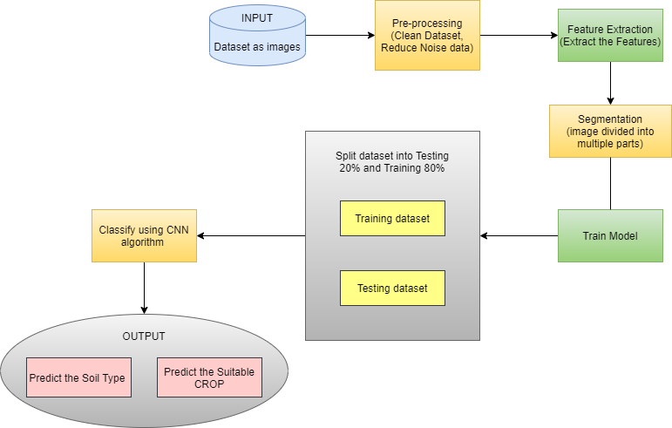
ARCHITECTURE

Slide 7
LITERATURE SURVEY
Sr no | Paper Title | Author | Abstract
1 | A study on various data mining techniques for crop yield prediction | Yogesh Gandge; Sandhya | India is a country where agriculture and agriculture related industries are the major source of living for the people. Agriculture is a major source of economy of the country. It is also one of the country which suffer from major natural calamities like drought or flood which damages the crop. This leads to huge financial loss for the farmers thus leading to the suicide. Predicting the crop yield well in advance prior to its harvest can help the farmers and Government organizations to make appropriate planning like storing, selling, fixing minimum support price, importing/exporting etc. Predicting a crop well in advance requires a systematic study of huge data coming from various variables like soil quality,pH, EC, N, P, K etc. As Prediction of crop deals with large set of database thus making this prediction system a perfect candidate for application of data mining. Through data mining we extract the knowledge from the huge size of data. This paper presents the study about the various data mining techniques used for predicting the crop yield.

Slide 8
Sr no | Paper Title | Author | Abstract
1 | Crop prediction using predictive analytics | P. S. Vijayabaskar; R. Sreemathi; E. Keertanaa | This work is to construct a model for testing the soil fertility. It also suggests the crop which has to be planted depending upon the value obtained from the sensor. It also provides the regional wise information about the crop in the form of graph. We have farmer chat where the farmers can share and get idea from the expert by registering in this application. It also suggests the fertilizer which has to be added to the soil in order to increase the crop productivity. It helps the farmer to analyze the fertility of their yard and plant the better crop to increase their productivity and profit. It also provides the information about the fertilizer to be added in the soil and also provide the information about the nearby fertilizer shop.

Slide 9
Sr no | Paper Title | Author | Abstract
1 | Crop Yield Prediction using Machine Learning Techniques | Ramesh Medar; Vijay S. Rajpurohit; Shweta Shweta | Agriculture is the field which plays an important role in improving our countries economy. Agriculture is the one which gave birth to civilization. India is an agrarian country and its economy largely based upon crop productivity. Hence we can say that agriculture can be backbone of all business in our country. Selecting of every crop is very important in the agriculture planning. The selection of crops will depend upon the different parameters such as market price, production rate and the different government policies. Many changes are required in the agriculture field to improve changes in our Indian economy. We can improve agriculture by using machine learning techniques which are applied easily on farming sector. Along with all advances in the machines and technologies used in farming, useful and accurate information about different matters also plays a significant role in it. The concept of this paper is to implement the crop selection method so that this method helps in solving many agriculture and farmers problems. This improves our Indian economy by maximizing the yield rate of crop production

Slide 10
Methodology
Machine Learning:
Machine learning is an application of artificial intelligence (AI) that provides systems the ability to automatically learn and improve from experience without being explicitly programmed. Machine learning focuses on the development of computer programs that can access data and use it to learn for themselves
Image Processing:
Image processing is a method to perform some operations on an image, in order to get an enhanced image or to extract some useful information from it. It is a type of signal processing in which input is an image and output may be image or characteristics/features associated with that image.

Slide 11
methodology
ALGORITHM
Convolutional Neural Network (CNN):-
A Convolutional Neural Network is a Deep Learning algorithm which can take in an input image, assign importance to various aspects/objects in the image and be able to differentiate one from the other. It is a class of artificial neural networks that has become dominant in various computer vision tasks, is attracting interest across a variety of domains, including radiology. CNN is designed to automatically learn spatial hierarchies of features through backpropagation by using multiple building blocks, such as convolution layers, pooling layers, and fully connected layers. The first two layers convolution and pooling perform feature extraction whereas the third layer a fully connected maps the extracted features into final output, such as classification.

Slide 12
Feasibility and scope
We have to collect all required data by giving GPS locations of a land and by taking access from Rain forecasting system of by the government, we can predict crops by just giving GPS location. Also, we can develop the model to avoid over and under crisis of the food.

Slide 13
Software
Coding Language : python
IDE : spyder
Software : Anaconda nevigator

Slide 14
Hardware
Processor : Pentium –IV
Speed : 1.1 Ghz
RAM : 512 MB(min)
Hard Disk : 40 GB
Key Board : Standard Windows Keyboard
Mouse : Two or Three Button Mouse
Monitor : LCD/LED

Slide 15
Technical risk and backup plan
Technical risks: If the model training get interrupted because of any reason then system can not give accurate result.
Backup plan: we are going to make copy of model so if the model training get interrupt or fail then we can go with previous copy of model.

Slide 16
Advantages
Predicting productivity of crop in various climatic conditions can help farmer and other partners in essential basic leadership as far as agronomy and product decision.
This model can be used to select the most excellent crops for the region and also its yield thereby improving the values and gain of farming also.

Slide 17
Disadvantages
Obligatory Crop Diversification.
Requires More Knowledge and Skills.
The Difference in Growing conditions.

Slide 18
PROJECT TIMELINE CHART
NO | TASK | DURATION(Days)
1 | Group Formation | 4
2 | Decide Area Of Interest | 4
3 | Search Topic | 5
4 | Topic Selection | 5
5 | Sanction Topic | 5
6 | Search Related Information | 12
7 | Understanding Concept | 7
8 | Search Essential Document(IEEE & White Paper, Software) | 6
9 | Problem Definition | 2
10 | Literature Survey | 5
11 | SRS | 14
12 | Project Planning | 2

Slide 19
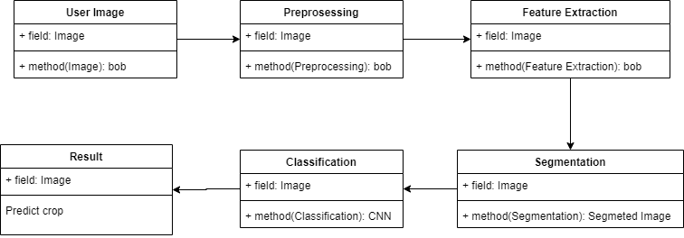
Structural Diagram
Class diagram:-

Slide 20
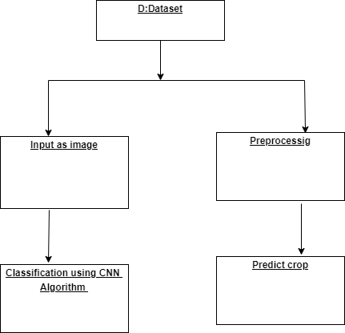
Object diagram

Slide 21
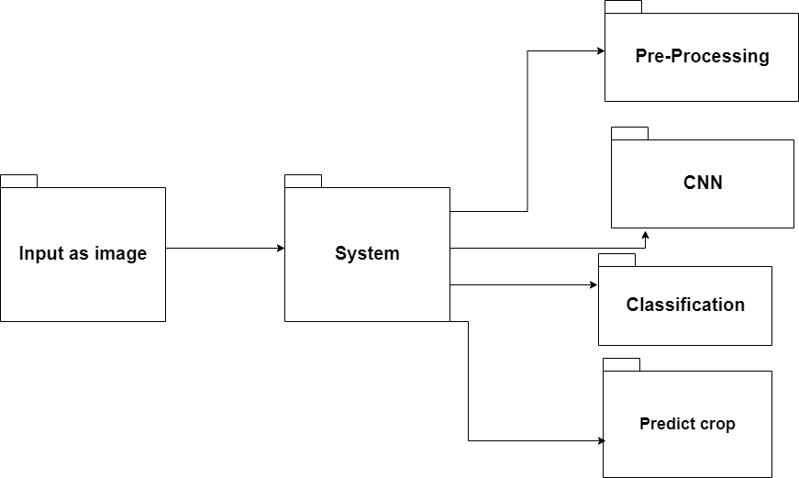
Package Diagram

Slide 22
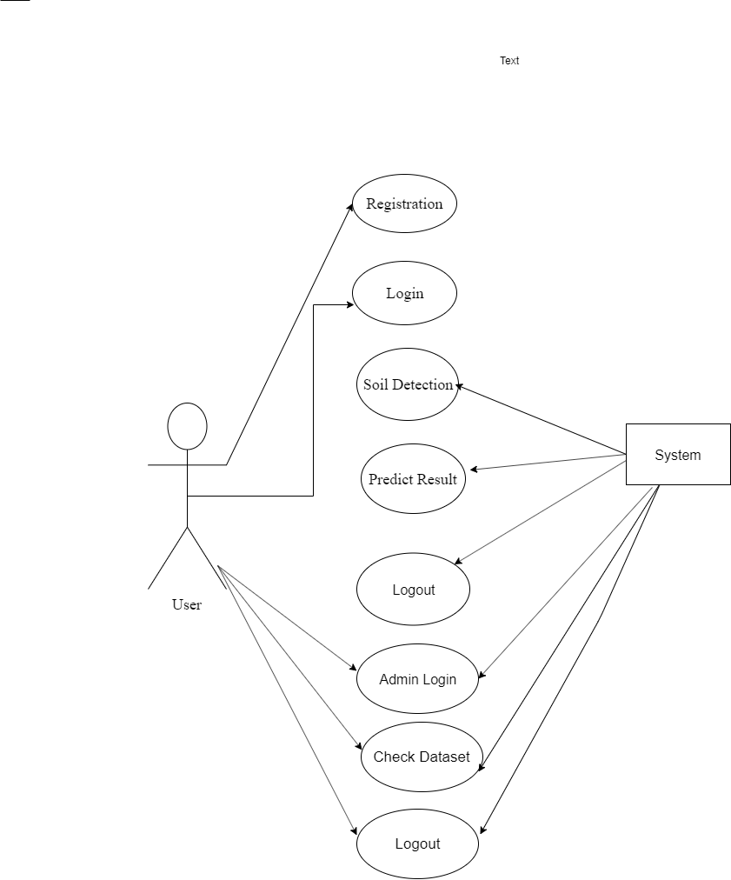
Use case:-

Slide 23
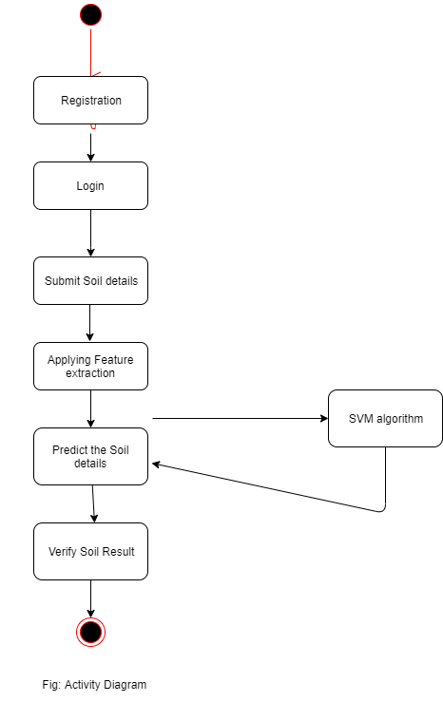
Activity:-

Slide 24
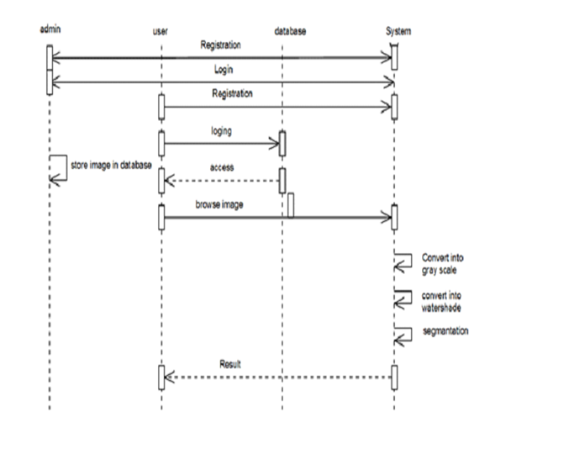
Sequence:-

Slide 25
CONCLUSION
Agriculture is the field which helps in economic growth of our country. But this is lacking behind in using new technologies of machine learning. Hence our farmers should know all the new technologies of machine learning and other new techniques. These techniques help in getting maximum yield of crops. Many techniques of machine learning are applied on agriculture to improve yield rate of crops. These techniques also help in solving problems of agriculture. We can also get the accuracy of yield by checking for different methods. Hence we can improve the performance by checking the accuracy between different crops.

Slide 26
Reference
[1] Prof. D.S. Zingade ,Omkar Buchade ,Nilesh Mehta ,Shubham Ghodekar ,Chandan Mehta “Crop Prediction System using Machine
Learning”.
[2] Ashwani kumar Kushwaha, Swetabhattachrya “crop yield prediction using agro algorithm in hatoop”.
[3] Girish L, Gangadhar S, Bharath T R, Balaji K S, Abhishek K T “Crop Yield and Rainfall Prediction in Tumakuru District using Machine Learning”.
[4] Rahul Katarya, Ashutosh Raturi, Abhinav Mehndiratta, Abhinav Thapper “Impact of Machine Learning Techniques in Precision Agriculture”.
[5] Pijush Samui, Venkata Ravibabu Mandla, Arun Krishna and Tarun Teja “Prediction of Rainfall Using Support Vector Machine and Relevance Vector Machine”.
[6] Himani Sharma, Sunil Kumar “A Survey on Decision Tree Algorithms of Classification in Data Mining”.
[7] Pavan Patil, Virendra Panpatil, Prof. Shrikant Kokate “Crop Prediction System using Machine Learning Algorithms

